Slide 1
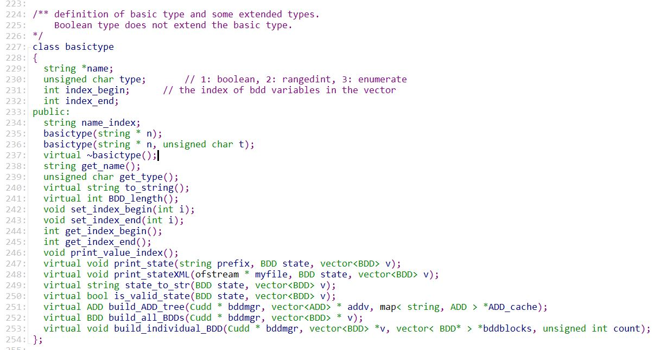
P. 0 – OOP的封装、继承和多态
父类
多个构造函数、重载(overload)→单个类内的多态(多态性的一种表现)
virtual成员函数+重写(override) = (父子间的)多态(多态的另一种表现)

Slide 2
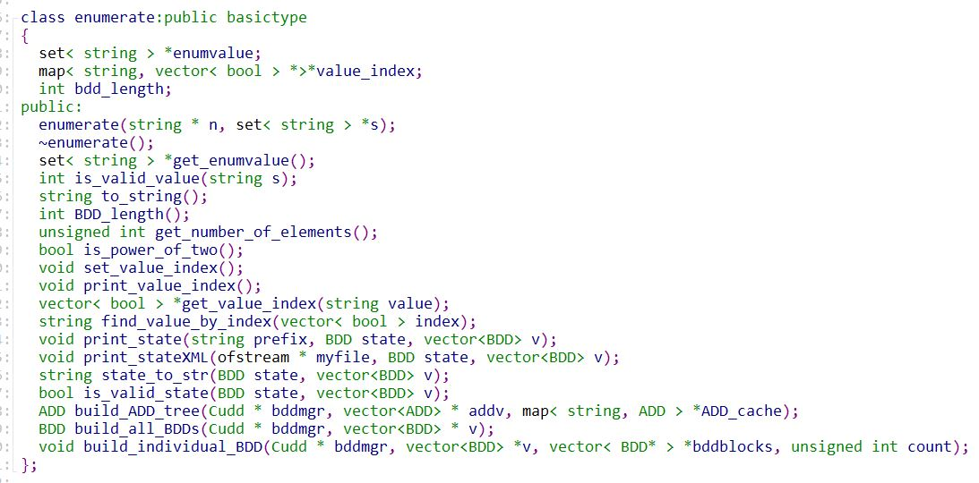
P. 0 – OOP的封装、继承和多态
子类1
构造函数
重写(override)父类的成员函数 → 多态(polymorphism)

Slide 3
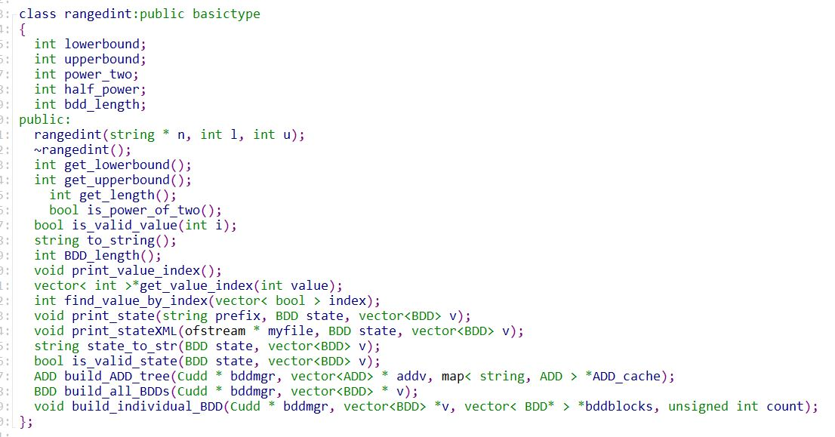
P. 0 – OOP的封装、继承和多态
子类2
构造函数
重写(override)父类的成员函数 → 多态(polymorphism)
Notes:
父对象就可以根据当前赋值给它的子对象的特性以不同的方式运作。简单的说：允许将子类类型的指针赋值给父类类型的指针

Slide 4
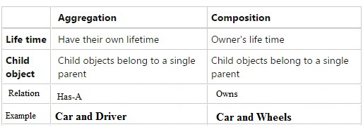
P. 0 – OOP的UML

Slide 5
CS100
Introduction to Programming
Tutorial 5: Composition, Initializer lists, include guards, and inheritance

Slide 6
Problem 1 Basic implementation of a class

Slide 7
Implement class Screen
The private member variables are int m_width int m_height
The public interface has
One accessor/mutator procedure for each member variable (GetWidth, SetWidth, GetHeight, SetHeight)
Exactly one constructor which takes two integer parameters to give initial values to the width and height
One addition procedure to return the number of pixels on the screen (int GetNumberPixels())
Note: The number of pixels is equal to width * height
Separate the declaration and implementation into 2 files called Screen.cpp / Screen.hpp

Slide 8
Test class Screen
Test your screen class using a separate file called main.cpp, which contains #include <stdlib.h> #include <stdio.h> #include "Screen.hpp” int main() { Screen myScreen( 640, 480 ); printf( "The number of pixels on my screen ” ); printf( "is %d\n", myScreen.GetNumberPixels() ); return 0; }
Compile using the command g++ Screen.cpp main.cpp –o main

Slide 9
Problem 2 Compositional Relationships (on initializer lists and include guards)

Slide 10
Implement class Computer
Only one private member variable (compositional relationship!) Screen m_screen
The public interface has
One accessor/mutator procedure for m_screen (GetScreen, SetScreen)
Exactly one constructor which takes no parameters
Separate the declaration and implementation in 2 files called Computer.cpp / Computer.hpp

Slide 11
Test class Computer
Test your Computer class using a new main.cpp file which contains #include <stdlib.h> #include <stdio.h> #include "Computer.hpp” #include "Screen.hpp” int main() { Computer myComputer; printf( "My computer's screen has %d pixels\n", myComputer.GetScreen().GetNumberPixels() ); Screen myScreen(800,600); myComputer.SetScreen(myScreen); printf( "My computer's screen has %d pixels\n", myComputer.GetScreen().GetNumberPixels() ); return 0; }

Slide 12
Test class Computer
Try to compile using the command g++ Screen.cpp Computer.cpp main.cpp –o main
Questions:
What are the problems that you ran into?
How can we use an initializer list to construct computer?
How can we use include-guards to avoid double declarations?

Slide 13

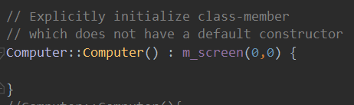

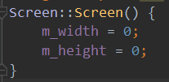
错因：main中调用Computer的default constructor, 而Screen无default constructor
Screen.h
法一：
Computer.cpp
法二：为Screen类创建一个 default constructor
Screen.h
Screen.cpp

Slide 14
The One Definition Rule (ODR) is an important concept in the C++ programming language.

Slide 15
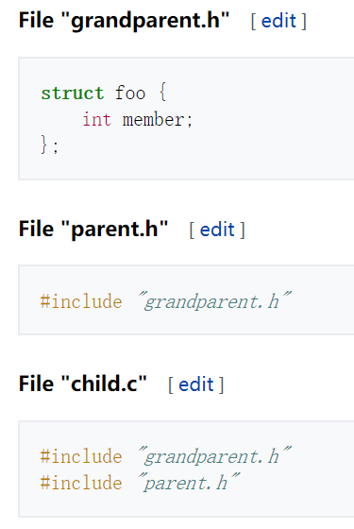
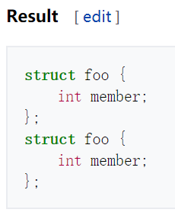

Slide 16
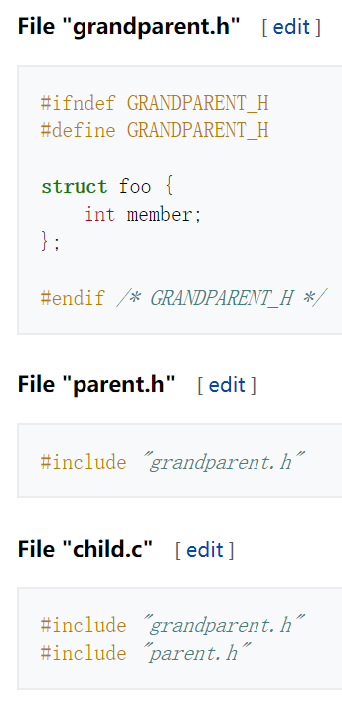
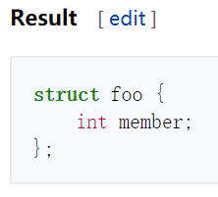

Slide 17
Problem 3 Precedence of Overriding over Overloading

Slide 18
Extend class Computer
Add a new member variable int m_flops
Extend/Modify the public interface
One additional accessor/mutator procedure for m_flops (GetFlops, SetFlops)
Modify constructor of Computer to take one int parameter to initialize m_flops

Slide 19
Implement class Laptop
Laptop inherits from Computer
Declare new member variable (divides flops if in battery mode) int m_slowDownFactor
The public interface has
One getter/setter for m_slowDownFactor (GetSlowDownFactor, SetSlowDownFactor)
Exactly one constructor which takes two integer parameters for setting m_flops (in base class) and m_slowDownFactor (in child class)
One new overloading procedure int GetFlops( int batteryMode )
if batteryMode = 0, the laptop is powered and flops is equal to the original value
If batteryMode = 1, the laptop is on battery and flops is equal to m_flops / m_slowDownFactor

Slide 20
Test class Laptop
Test your Laptop class using a new main.cpp file which contains #include <stdlib.h> #include <stdio.h> #include "Computer.hpp” #include "Screen.hpp” #include "Laptop.hpp” int main() { Laptop myLaptop( 1000, 2 ); printf( "In powered mode, my laptop has %d flops\n", myLaptop.GetFlops(0) ); printf( "In battery mode, my laptop has %d flops\n", myLaptop.GetFlops(1) ); return 0; }

Slide 21
Test class Laptop
Try to compile using the command g++ Screen.cpp Computer.cpp Laptop.cpp main.cpp –o main
Questions:
What are the problems that you ran into?
How can we use an initializer list to construct the members of the parent class?
By overloading the GetFlops procedure, can we still access the original GetFlops from the base class?
How to solve the problem?

Slide 22
Problem 4 Complex inheritance

Slide 23
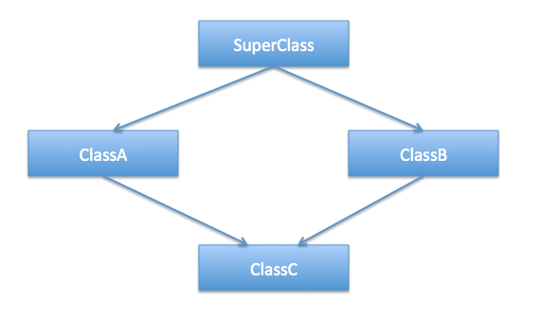
Diamond problem
Originates from multiple inheritance

Slide 24
Example
#include <iostream>
class LivingThing {
public:
void breathe() {
printf("I'm breathing as a living thing.\n”);
}
};
class Animal : public LivingThing {
public:
void breathe() {
printf("I'm breathing as an animal.\n”);
}
};
class Reptile : public LivingThing {
public:
void breathe() {
printf("I'm breathing as a reptile.\n”);
}
};
class Snake : public Animal, public Reptile {
public:
void breathe() {
printf("I'm breathing as a snake.\n”);
}
};
int main() {
Snake snake;
snake.breathe();
return 0;
}

Slide 25
Example
Example has been added to your gitlab project repository, in a sub-folder called DiamondCase

Slide 26
Does it compile and run?
g++ test0.cpp -o main

Slide 27
What about this?
#include <iostream>
class LivingThing {
public:
void breathe() {
printf("I'm breathing as a living thing.\n”);
}
};
class Animal : public LivingThing {
public:
void breathe() {
printf("I'm breathing as an animal.\n”);
}
};
class Reptile : public LivingThing {
public:
void breathe() {
printf("I'm breathing as a reptile.\n”);
}
};
class Snake : public Animal, public Reptile {
};
int main() {
Snake snake;
snake.breathe();
return 0;
}

Slide 28
Does it compile?
g++ test1.cpp -o main
What has happened?

Slide 29
What about this?
#include <iostream>
class LivingThing {
public:
void breathe() {
printf("I'm breathing as a living thing.\n”);
}
};
class Animal : public LivingThing {
};
class Reptile : public LivingThing {
};
class Snake : public Animal, public Reptile {
};
int main() {
Snake snake;
snake.breathe();
return 0;
}

Slide 30
Does it compile?
g++ test2.cpp -o main
What has happened?

Slide 31
How to solve the problem?
#include <iostream>
class LivingThing {
public:
void breathe() {
printf("I'm breathing as a living thing.\n”);
}
};
class Animal : public virtual LivingThing {
};
class Reptile : public virtual LivingThing {
};
class Snake : public Animal, public Reptile {
};
int main() {
Snake snake;
snake.breathe();
return 0;
}

